Slide 1
Multi-agent pathfinding in Warehouse Automation
Phillip Wong
Supervised by:
Daniel Harabor & Pierre Le Bodic
Notes:
Morning / Afternoon ~ Name - Phillip Wong ~ Proj: MAPF ~ Along with 2, Dan, Pierre

Slide 2
Multi-agent pathfinding
Finding paths for multiple agents to goal locations while ensuring no path conflicts
Objective: minimize sum of path distance
A1 |  |  | A2
T2 |  |  | T1

Slide 3
Multi-agent pathfinding
A1 |  |  | A2
T2 |  |  | T1

Slide 4
Multi-agent pathfinding
A1 |  | A2
T2 |  |  | T1

Slide 5
Multi-agent pathfinding
A1 | A2
T2 |  |  | T1

Slide 6
Multi-agent pathfinding
A1
T2 | A2 |  | T1

Slide 7
Multi-agent pathfinding
 | A1
A2 |  |  | T1

Slide 8
Multi-agent pathfinding
 |  | A1
A2 |  |  | T1

Slide 9
Multi-agent pathfinding
 |  |  | A1
A2 |  |  | T1

Slide 10
Multi-agent pathfinding
A2 |  |  | A2

Slide 11
Multi-agent pathfinding
A1 |  |  |  |  |  |  |  |  |  |  | T1
T2 |  |  |  |  |  |  |  |  |  |  | A2

Slide 12
Motivation
Warehouse Automation - pic
Video games – sc1
Logistics (Airports - pic)
Robotics (Search and Rescue – pic?)

Slide 13
Warehouse Automation
Multiagent pathfinding
Drive allocation
Order assignment
Replenishment
Battery
Shelving
Picking

Slide 14
Part-to-picker system
Kiva Systems
Peter Wurman
Automating the movement of inventory around the warehouse
Drive Units, Picking stations, Storage pods
Kiva Systems AKA Amazon Robotics

Slide 15
Part-to-picker system
Put Gif here

Slide 16
Part-to-picker systems
Amazon Picking Challenge
https://www.youtube.com/watch?v=3KlzVWxomqs
http://spectrum.ieee.org/automaton/robotics/industrial-robots/team-delft-wins-amazon-picking-challenge

Slide 17
Kiva Systems
Large scale - up to 1000 robots in a warehouse
Robots delivering inventory

Slide 18

Is it a solved problem?
State space grows
k agents
n nodes in the grid map
5 actions {up, down, left, right, wait} (branching factor)
$StateSpace=n^{5k}$

Slide 19
What is Multi-agent pathfinding?
Multiple agents moving to goal locations
For each agent find a conflict-free path to the goal
A tile can only have 1 agent at any time

Slide 20
Specifics of MAPF
Warehouse Automation
Grid-based map (no diagonal movement)
Objective Functions
Makespan
Sum of cost
Down-time
Cooperative multi-agent pathfinding

Slide 21
Solving MAPF
Optimal
Suboptimal
Guarantees
Bounded-suboptimal

Slide 22
Resolving Conflicts
Search
Find a path for each agent
Conflicts
Identify conflicts between paths
Replanning
Perform search again, reduce the number of conflicts

Slide 23
Why optimality?
Anytime
heursistically

Slide 24
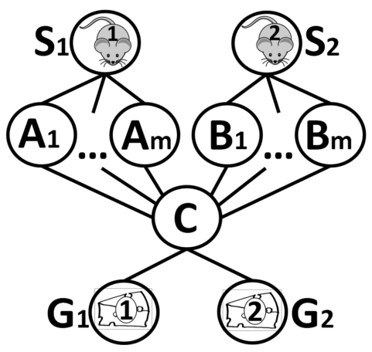
Conflict Based Search
State of the art: Conflict Based Search (CBS)
Disadvantage – branching
Constraint <agent, location, time>

Slide 25
Anim

Slide 26
Tree

Slide 27
Potential improvements
Search
Heuristics
Reducing search space
Conflicts
Trivial?
Replanning
Heuristics
Precomputing

Slide 28
Comparison
Alternative routes
Bypass paper?
Branching

Slide 29
Contributions
Single agent pathfinding
Linear Programming
Branch and price
Jump Point Search
Compressed Path Databases

Slide 30
Integer programming

Slide 31
Current progress
Warehouse Simulation
Picking station
Drive Units
Order assignment
Single agent pathfinding (A*)
Learning Integer Programming

Slide 32
Simulation

Slide 33
Expected outcomes?
Relation to warehouse

Slide 34
Future Work

